Slide 1
Optical Diagnostics: Transmission Electron Microscopy & Laser Extinction
Fire Protection Laboratory Methods Day
June 25, 2014
Paul M. Anderson
Graduate Research Assistant
University of Maryland
Department of Fire Protection Engineering

Slide 2
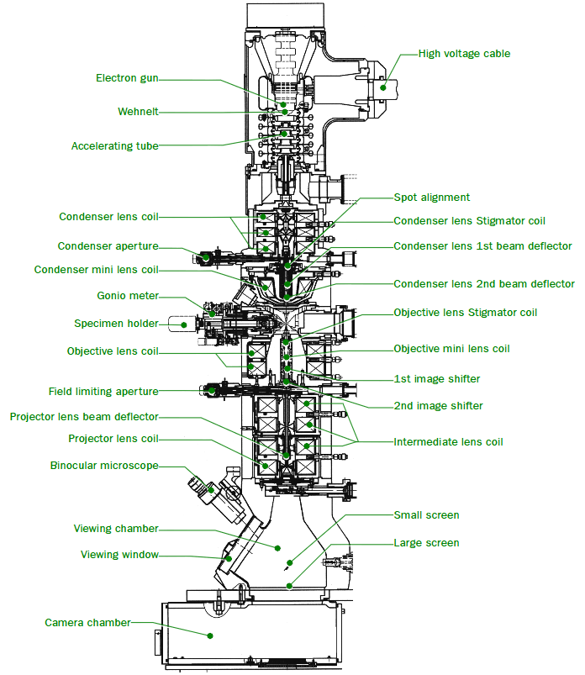
Transmission Electron Microscopy
Basic Principles
Beam of electrons thermionically ejected from electron gun
Beam travels through series of apertures and magnetc lenses

Slide 3
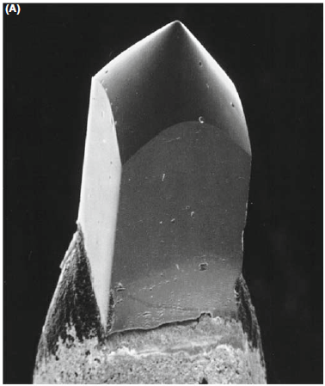
Transmission Electron Microscopy
Basic Principles
Beam of electrons thermionically ejected from electron gun
LaB₆ crystal tip of a thermionic electron gun
Notes:
Lanthanum Hexaboride

Slide 4
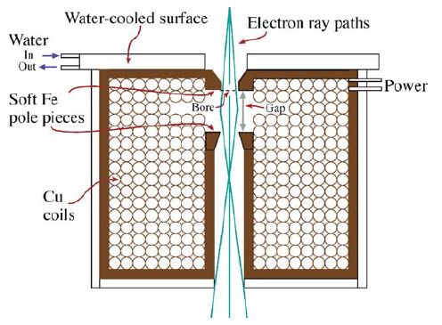
Transmission Electron Microscopy
Basic Principles
Beam travels down evacuated column (10⁻⁴ Pa) through aperture and electro-magnetic lens before reaching specimen
Electromagnetic lens schematic
Notes:
Lanthanum Hexaboride

Slide 5
Transmission Electron Microscopy
Basic Principles
The electron beam interacts with the specimen held on a 3.05 mm TEM grid.
Typical TEM grids with copper wire mesh and carbon substrate
Notes:
Lanthanum Hexaboride

Slide 6
Transmission Electron Microscopy
Basic Principles
Electron beam is transmitted through the specimen, travels through additional lenses & apertures and imaged onto a fluorescent screen or CCD camera
Notes:
Lanthanum Hexaboride

Slide 7
Transmission Electron Microscopy
Soot at 25,000 magnification
Notes:
Lanthanum Hexaboride

Slide 8
Transmission Electron Microscopy
Soot at 500,000 magnification
Notes:
Lanthanum Hexaboride

Slide 9
Transmission Electron Microscopy
Key Concepts
Beam must transmit - requires very thin specimen (about 100-150nm for a 200kV TEM)
UMD Nanocenter TEM can achieve good resolution up to magnification of about 800,000x
Atomic resolution achievable with High Res or Field Emission TEM
Specimen composition can be analyzed concurrently if TEM is equipped with x-ray spectrometer (available in UMD Nanocenter)
Notes:
Lanthanum Hexaboride

Slide 10
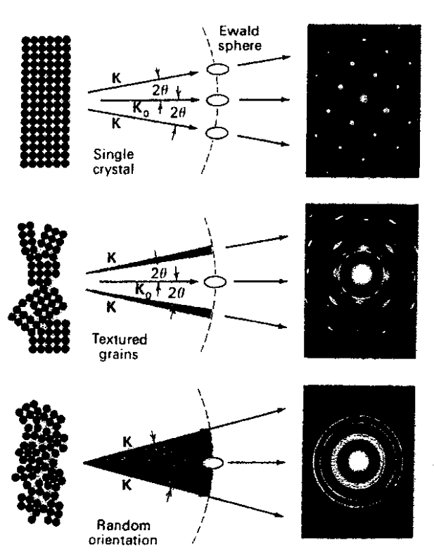
Transmission Electron Microscopy
Key Concepts
Diffraction pattern due to Bragg scattering of electrons with specimen can be imaged.
Gives info about crystalline structure of sample
Different structures of a specimen affect the diffraction pattern.
Notes:
Lanthanum Hexaboride

Slide 11
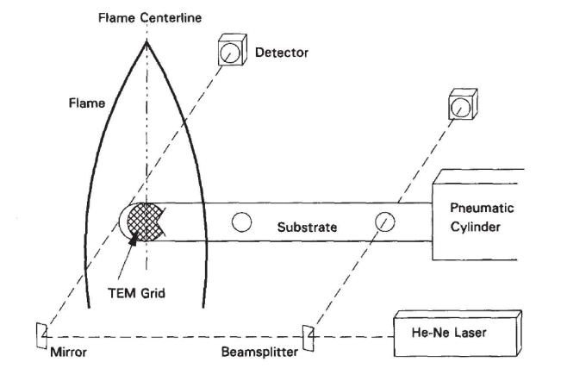
Transmission Electron Microscopy
Aerosol sample collection methods
Thermophoretic probe
Thermophoretic precipitator
(Koylu et al., 1997)
Notes:
Lanthanum Hexaboride

Slide 12
Transmission Electron Microscopy
Additional information:
P.M. Anderson, The Transmission Electron Microscopy Lab Companion, (2012).
D. B. Williams and C. B. Carter, Transmission Electron Microscopy: A Textbook for Materials Science, New York: Springer Science & Business Media, (2009).
R.A. Dobbins and C.M. Megaridis, C.M., Morphology of flame-generated soot as determined by themophoretic sampling. Langmuir, 2 (1987), 254-259.
A.D. Maynard, The Development of a New Thermophoretic Precipitator for Scanning Transmission Electron Microscope Analysis of Ultrafine Aerosol Particles. Aerosol Science and Technology, 23 (1995), 521-533.
Notes:
Lanthanum Hexaboride

Slide 13
Laser Extinction Theory
Aerosols attenuate incident light intensity.
Beer’s Law:
For particles much smaller than wavelength of incident light, Rayleigh scattering holds. For spherical particles this is:
E(m) = Refractive index absorption fuction
f_{s} = aerosol volume fraction
For soot, E(m)=0.26 for a refractive index of m = 1.57 – 0.56 i
L
Incidence
I⁰
I
Transmittance

Slide 14
Laser Extinction Theory
Laser extinction is a line-of-sight method. We must integrate over the path length:
Aerosol volume fraction can be found from:
A is the deconvolution operator (Abel Transform), which is needed in the radially axisymmetric case.
Laser is a good choice owing to monochromaticity

Slide 15
Laser Extinction Experimental
Laser
Line
Filter
Flame
Parabolic Mirror
Planar Mirror
Lens
Decollimator
Neutral Density Filter
Diffusers
Pinhole
Camera Lens
Vibrator
Camera
7 mW He-Ne Laser at 632.8 nm

Slide 16
Laser Extinction Experimental
Diffuser and vibrator
Laser is highly coherent and results in interference patterns (i.e., laser fringes).
Diffuser is used to reduce the laser coherency.
Vibrator is used to obtain temporal averaging.
Laser background with fringes (contrast enhanced)

Slide 17
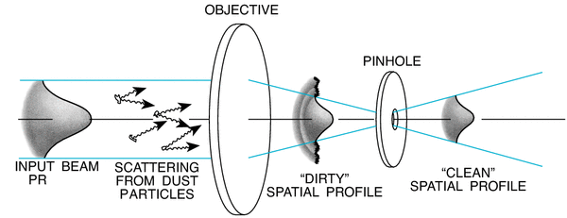
Wavelength and Spatial Filters
Laser line filter:
632.8 nm bandpass filter
1 nm FWHM
Removes most flame irradiance
Spatial filter (objective + pinhole)

