Slide 1
Optical Thermometry
Lab Methods Day
June 25, 2014
Haiqing Guo
Dept. of Fire Protection Engineering
hguo@umd.edu

Slide 2
Introduction
Optical thermometry, i.e. soot pyrometry, provides soot temperature and soot concentration information in flames.
Soot radiance in flames was detected and converted to soot temperature (K) and soot volume fraction (ppm).
This technique is nonintrusive.

Slide 3
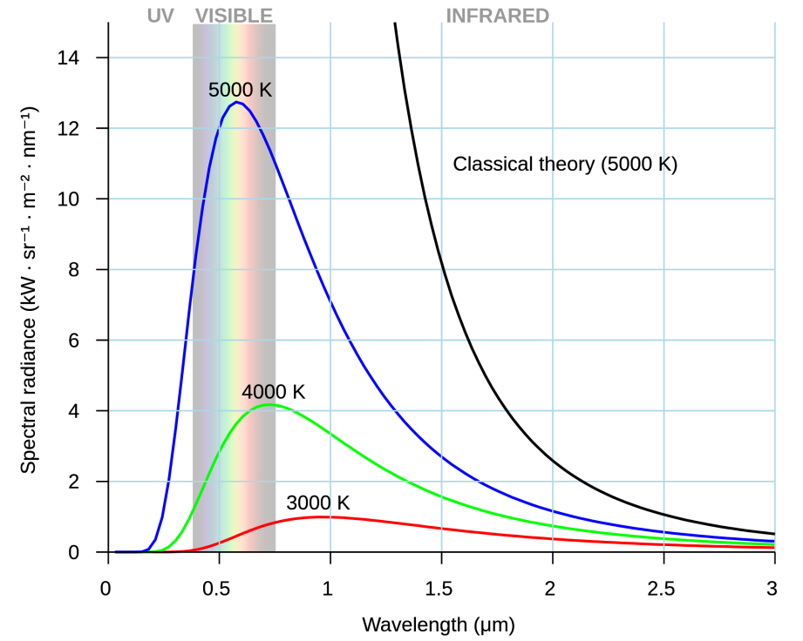
Soot Radiance
The spectral radiance of hot soot is:
For hot regions in the visible or near-IR:
wikipedia.org
Choose wavelength
B_{λ}
c
h
k
T
ε
λ
Blackbody spectral radiance
Speed of light
Planck’s constant
Boltzmann’s constant
Temperature
Emissivity
Wavelength
Determine emissivity
Measure radiance (e.g., with filtered digital camera)

Slide 4
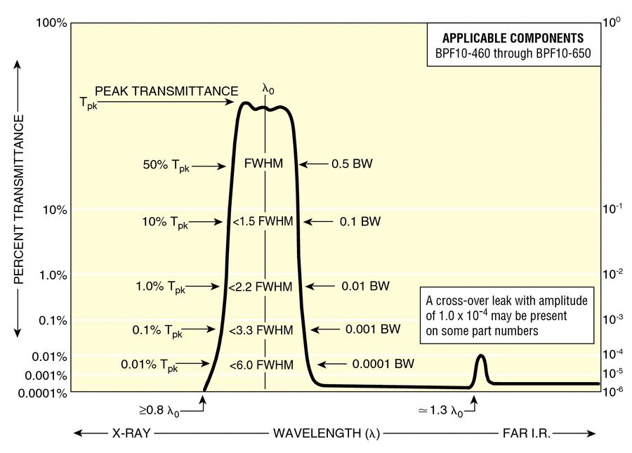
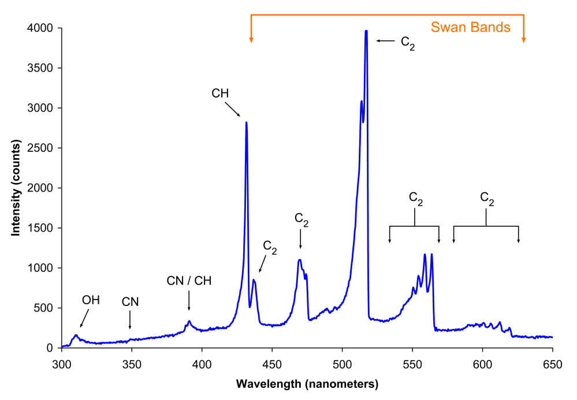
Bandpass Filters
newport.com
wikipedia.org
Choose two or more bandpass filters, e.g., at 450, 650, and 900 nm.
Bandwidth choice involves a tradeoff between error and signal strength. A FWHM of 10 nm is most common.
Avoid chemiluminescence spectra (e.g., Swan Bands) and should be far separated.

Slide 5
Soot Emissivity
Determine emissivity
Rayleigh scattering can be assumed because soot primary particles (d_{p} ≈ 30 nm) are smaller than the Rayleigh limit.
Assume:
E(m)
f_{s}
K_{abs}
K_{ext}
Refractive index absorption function
Soot volume fraction
Absorption coefficient
Extinction coefficient
Notes:
  The variation of E(m) with soot morphology, soot age, and other conditions is not fully understood.
  Soot volume fraction f_{s} is unknown.

Slide 6
Camera Signal
Measure soot radiance
CCD/CMOS cameras are attractive owing to high bit depth (e.g, 14), higher pixel counts (12M), larger sensor arrays (36 x 24 mm), and decreased noise.
Irradiance incident on the CMOS sensor I:
a Constant that accounts for pixel size, fill factor, and sensitivity
GS Grayscale divided by shutter time
ξ Constant that accounts for magnification and lens light losses
τ Bandpass filter transmissivity
Notes:
W is spectral radiance from slide 4.

Slide 7
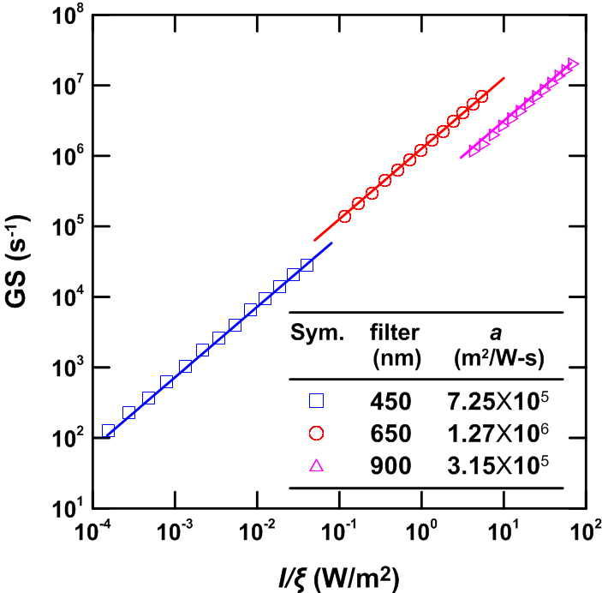
Camera Calibration
Constant a obtained from blackbody furnace calibration.
  Emissivity of ε = 0.99 ± 0.01
  Uniform and stable temperature
T range: 900 − 1200 ºC
T increment: 25 ºC
T accuracy: ± 0.1 ºC

Slide 8
Line-of-Sight Radiance
Bandpass Filter
Flame cross section
x
x
(x,y)dy
y
The exponent term describes the extinction effect from soot. For optically thin cases, it is negligible.

Slide 9
GS to T Conversion
For optically thin conditions:
Tomography can convert the line-of-sight integrated irradiance I(x) into the local irradiance I(x,y).
Required
High uncertainty
From filter manufacturer
Objective
From measured grayscale, blackbody calibration, and tomography

Slide 10
Ratio Pyrometry
With multiple bandpass filters, ratio pyrometry allows f_{s} and E(m) to be cancelled:
and
where C = a τ Δλ / λ⁶ is a constant for each filter and camera that does not vary with T or E(m).

Slide 11
f_{s} from Emissions
The pyrometry determined temperature can be used to obtain the soot volume fraction for each filter.
A soot refractive index of m = 1.57 – 0.56 i is commonly assumed, which yields E(m) = 0.26.
Any uncertainty in T is amplified in determining f_{s}.

Slide 12
Camera Tradeoffs
Digital cameras require considering:
  Response linearity (gamma correction must be avoided)
  Parallel light collection (small aperture)
  Sufficient depth-of-field (small aperture)
  High spatial resolution (big sensor, small object distance)
  High temporal resolution (fast shutter)
  High signal resolution (high color bit-depth)
  Ideal exposures should have high GS but not be saturated in any color plane. This presents tradeoffs with aperture, shutter, and ISO.

Slide 13
Deconvolution
3D tomographic reconstruction requires multiple imaging at different locations.
For axisymmetric flames, tomography from I(x) to I(r) can be simplified and requires only one image.
Commonly used deconvolution algorithms:
  Abel transform
  Onion peeling
  Filtered back projection

Slide 14
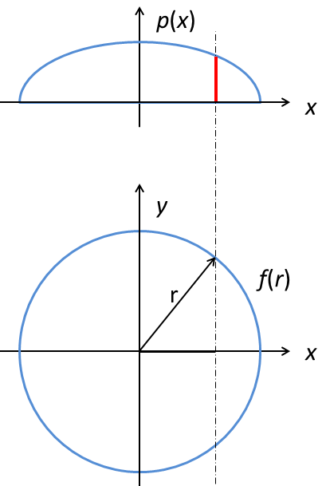
Abel Transform
Based on an exact solution
Requires discretization
Line-of-sight integration of the flame property f(r) is:
Substituting y with x and r following r² = x² + y² yields:
Analytical inverse of the above equation yields:
Sensitive to noise
Singularity at x = r

Slide 15
Abel Transform
Lower integration limit region, solved with a open type numeric integration (e.g. Steffensen’s formula).
Solved with a regular closed type integration scheme (e.g. Simpson’s rule).
Alternatively, a discretized form is simpler and more commonly used.

Slide 16
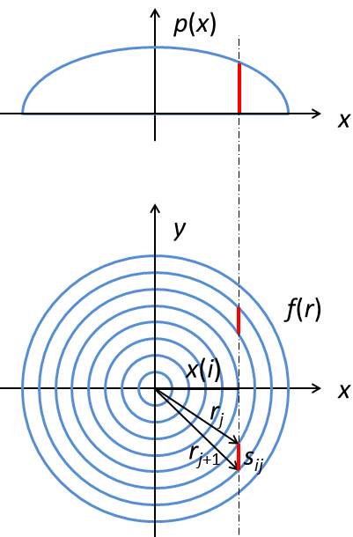
Onion Peeling
Based on numerical approximation.
The domain is divided into a series of concentric rings.
Within each ring, the value of the spatial function f(r) is assumed to be constant.
For the i-th cord and the j-th ring:
s_{ij} is a geometric matrix
Deconvolve Form:

Slide 17
Deconvolution
Sufficient spatial resolution is required for enough accuracy.
Due to the differentiation, deconvolution is very sensitive to noise. Data smoothing can help:
  Low-pass filter
  Gaussian filter
  Savitzky-Golay filter
Deconvolution results from prescribed projection data. Spatial resolution is 0.05 mm/pixel.

Slide 18
Laminar Jet Diffusion Flame
A Santoro coflow burner was used.
The flame was steady and axisymmetric.
Fuel tube: 11.1 mm ID
Air tube: 101 mm ID
Glass beads
Air
Fuel

Slide 19
C₂H₄ Flame
Fuel: ethylene
Oxidizer: coflowing air.
Flame height: 88 mm
  Steady
  Optically thin
  Axisymmetric

Slide 20
Soot Temperatures
Low soot concentration

Slide 21
T Contours
T range: 1600-1850 K.
Spatial resolution: 23 µm
Longest shutter time:
125 ms
Precision: ± 0.1 K
Uncertainty: ± 50 K (95% confidence)

Slide 22
Soot Emission Concentrations

Slide 23
Results
f_{s} results
 | Emission | Extinction
f_{s} (ppm) | 0.1-10 | 0.2-10
Res. (µm) | 23 | 34
t (ms) | 125 | 167
Precision (ppm) | ± 4×10⁻⁴ | ± 6×10⁻⁴
Uncertainty | ± 30% | ± 10%

Slide 24
Limitations
Only applicable for sooting flame.
Needs to be optically thin (otherwise complicated corrections are required).
Needs to be steady.
Needs to be axisymmetric.
For detailed information, please refer to “H. Guo, J.A. Castillo, P.B. Sunderland, Digital Camera Measurements of Soot Temperature and Soot Volume Fraction in Axisymmetric Flames, Applied Optics 52 (2013) 8040-8047.”

