Slide 1
Micro Combustion Calorimetry
&
Milligram-scale Flame Calorimetry
Fernando Raffan
Lab Methods Day

Slide 2
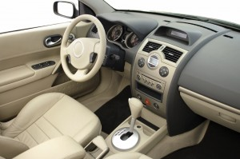
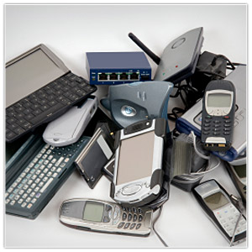
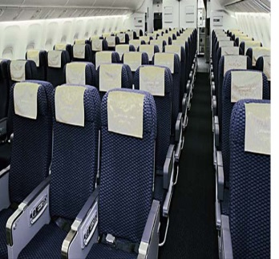
Flame Retardants
Introduction
Flame Retardants
Current Test Methods
General Objectives
O₂ Consumption Calorimetry
MCC
Objectives and Approach
Apparatus Description
Calibration
Operation
Data Analysis
MFC
Objectives and Approach
Apparatus Description
Calibration
Operation
Data Analysis
Derived Data
MCC and MFC HRR
Combustion Efficiency
CO yields
Conclusions
Brominated flame retardants (BFRs) are widespread in their use due to their relative low cost/high performance
Recently, BFRs have been found to accumulate in human tissues and persist in the environment^{1,2}. Industry is moving towards suitable replacements
Understanding mechanisms of BFRs as gas phase combustion inhibitors can guide the research community towards a suitable replacement
A small scale screening tool for BFR replacements is highly desirable as it will considerably drive down costs during product development
1. http://www.epa.gov/oppt/existingchemicals/pubs/actionplans/pbde.html
2. http://www.nist.gov/el/fire_research/upload/1-Axelrad.pdf

Slide 3
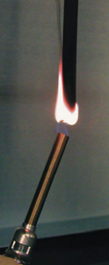
UL-94
Qualitative test only
Sample is ignited, source is removed
Check for extinction and dripping
Rating

Slide 4
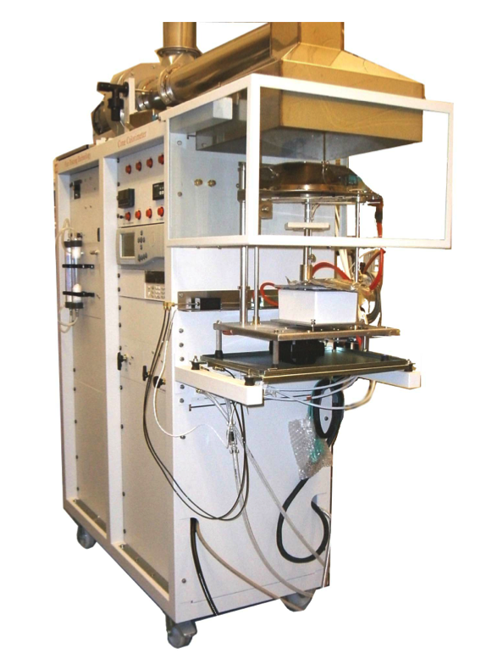
Cone Calorimeter
  Commonly used in fire testing
  Controlled incident heat flux
  Requires samples on the order of grams (expensive for new materials)
  Laminar-Transitional Diffusion flames
  Incomplete combustion

Slide 5
General Objectives
Introduction
Flame Retardants
Current Test Methods
General Objectives
O₂ Consumption Calorimetry
MCC
Objectives and Approach
Apparatus Description
Calibration
Operation
Data Analysis
MFC
Objectives and Approach
Apparatus Description
Calibration
Operation
Data Analysis
Derived Data
MCC and MFC HRR
Combustion Efficiency
CO yields
Conclusions
Scale down sample size, yet obtain meaningful results
Determine heat release rates and total heats of combustion of materials using mg sized samples
Use this information to characterize material flammability
Explore the effect of FR additives on performance

Slide 6
O₂ Consumption Calorimetry
Huggett’s empirical observation: for most fuels, a nearly constant net amount of heat is released per unit mass of oxygen consumed for combustion.
  E = 13.1 + 0.6 kJ/g-O₂

Slide 7
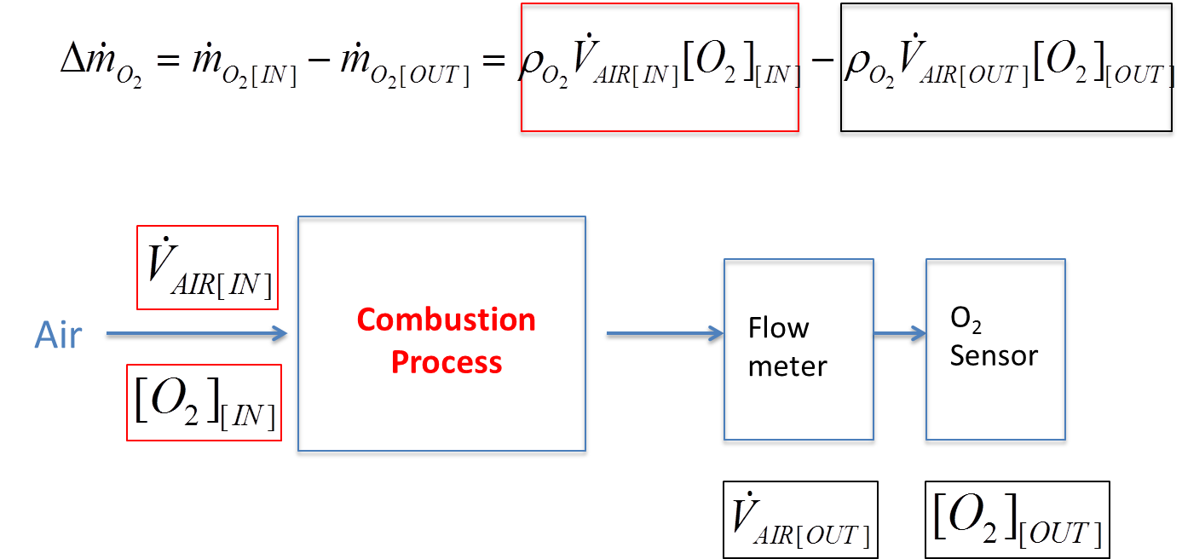
O₂ consumption calorimetry

Slide 8
MCC
Objective
Measure heat release rate and total heat release of pyrolyzable materials (polymers) using mg sized samples
Approach
Uncouple pyrolysis from combustion
Premix volatiles with O₂
High temperature furnace (900 C)
Long residence time (complete combustion)

Slide 9
MCC Diagram
O₂ inlet
O₂ sensor
Drierite
Flow
Meter
Furnace coil
Sample
N₂ inlet
Pyrolizer coil

Slide 10
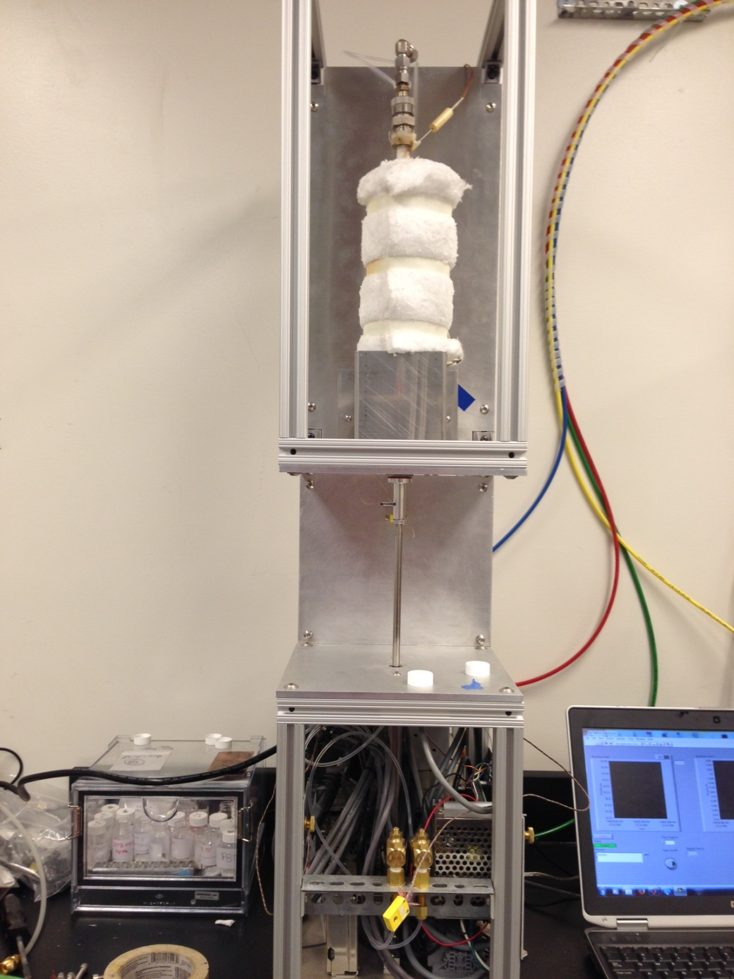
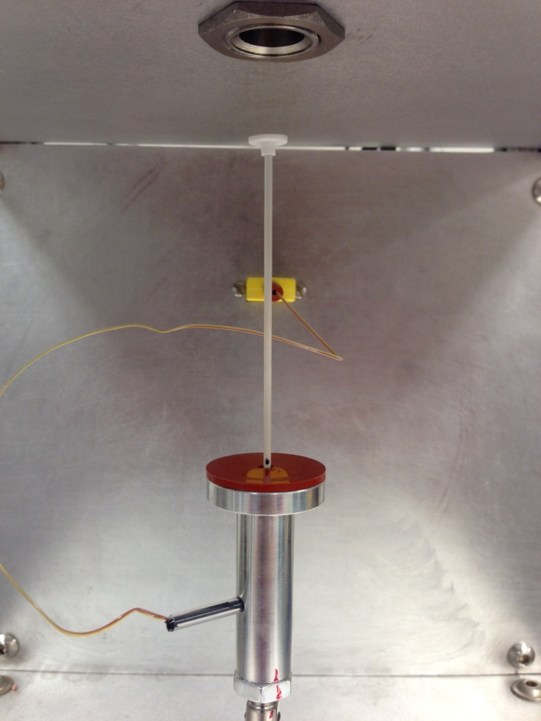

Slide 11
MCC Calibration
Dedicated VI
  Run test with known metallic samples
  Compares measured temperature profile during pyrolyzer heating to known melting point of metal sample
  Compensates for difference
  Creates calibration file
Calibrating flow meters and O₂ sensor
  Connect a reference flowmeter in series. Calibrate reference vs. MCC flow meter readout
  Purge furnace and flow N₂ only. Record O₂ sensor voltage.
  Purge furnace and flow calibration air (known O₂ concentration). Record sensor voltage
  Apply linear relationship [O₂]=mV+b

Slide 12
MCC Operation
Sample preparation steps
  Cut/grind polymer to sub-mg pieces
  Condition in low humidity chamber
  Carefully weigh sample < 4 mg
Instrument preparation
  Open gas bottles and verify flowrates
  Start furnace
  Change setpoints if needed (default, no changes required)
Run Test
  Load sample carefully on pedestal
  Activate piston. Wait for flow rates to stabilize.
  Start process
  Data output (all flow rates, pyrolyzer T, HRR)

Slide 13
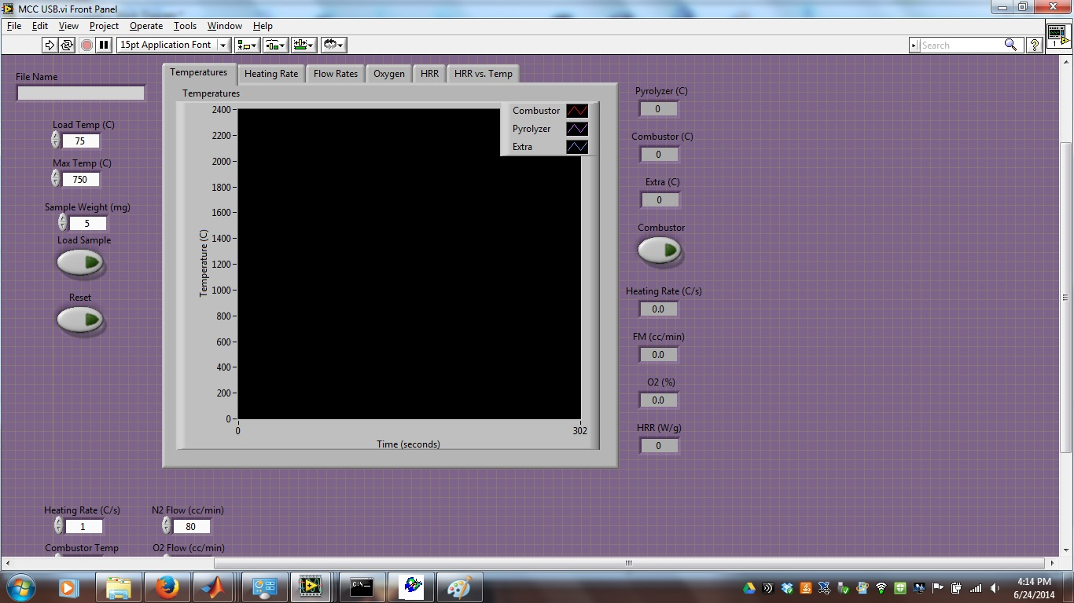
MCC Operation

Slide 14
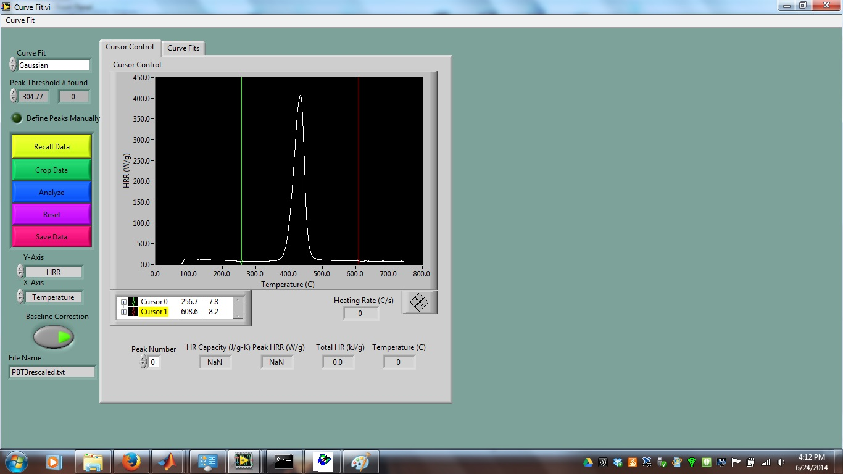

MCC Data Analysis

Slide 15
Data analysis
Introduction
Flame Retardants
Current Test Methods
General Objectives
O₂ Consumption Calorimetry
MCC
Objectives and Approach
Apparatus Description
Calibration
Operation
Data Analysis
MFC
Objectives and Approach
Apparatus Description
Calibration
Operation
Data Analysis
Derived Data
MCC and MFC HRR
Combustion Efficiency
CO yields
Conclusions
Run data analyzer
  Trim data endpoints
  Calculate total heat release
  Calculate derived quantities
FR sensitivity
  MCC does not detect FR effect on combustion efficiency
  Only effect of composition on heat release is detected
  Useful to determine HRR and total heat of combustion

Slide 16
MFC
Objective
Design and implement an apparatus that can study the flaming combustion of milligram scale solid samples in a well-controlled fashion
Correlate the measured gas-phase combustion efficiency with MCC and cone calorimetry results
Develop steps towards measurement of flame temperatures in polymers with/without flame retardants
The MFC
Milligram-scale Flame Calorimeter

Slide 17
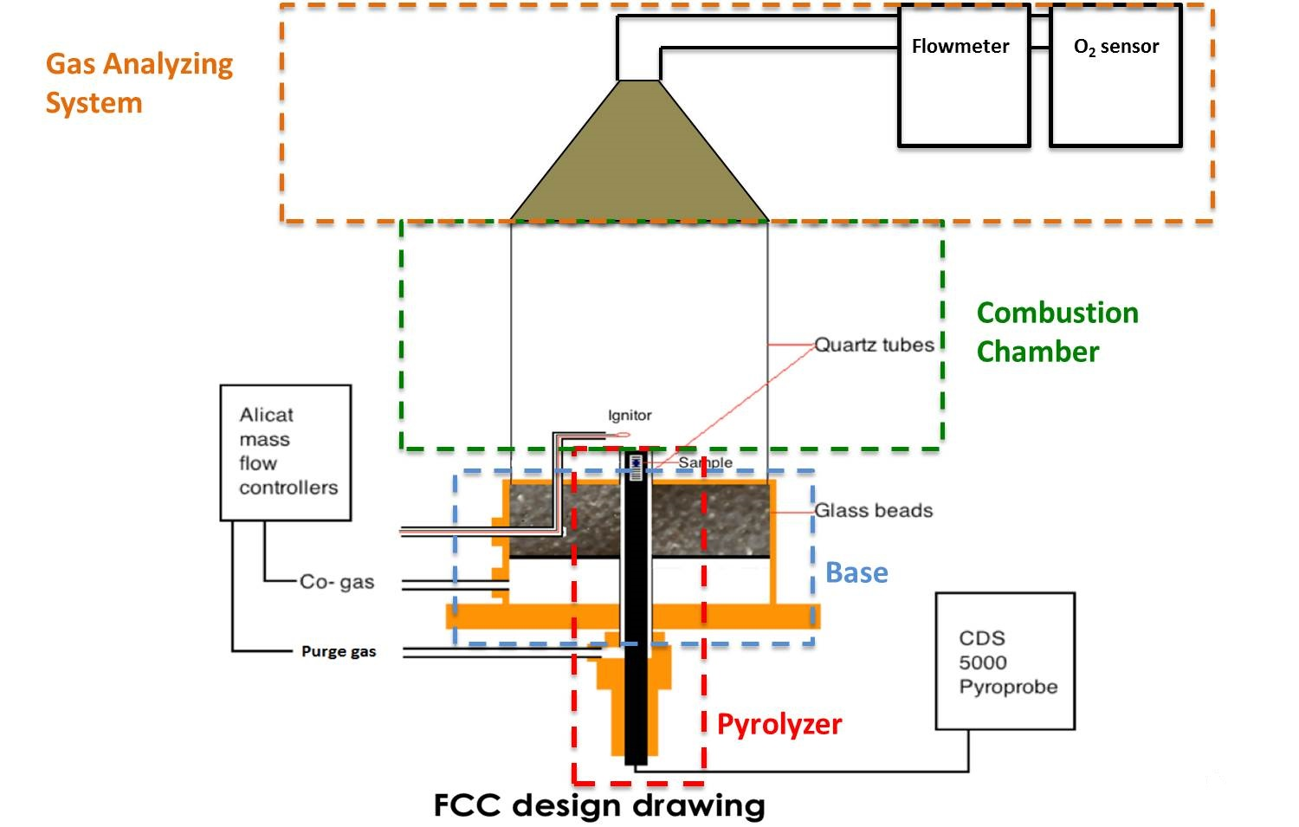
Design and Capabilities
Introduction
Flame Retardants
Current Test Methods
General Objectives
O₂ Consumption Calorimetry
MCC
Objectives and Approach
Apparatus Description
Calibration
Operation
Data Analysis
MFC
Objectives and Approach
Apparatus Description
Calibration
Operation
Data Analysis
Derived Data
MCC and MFC HRR
Combustion Efficiency
CO yields
Conclusions

Slide 18
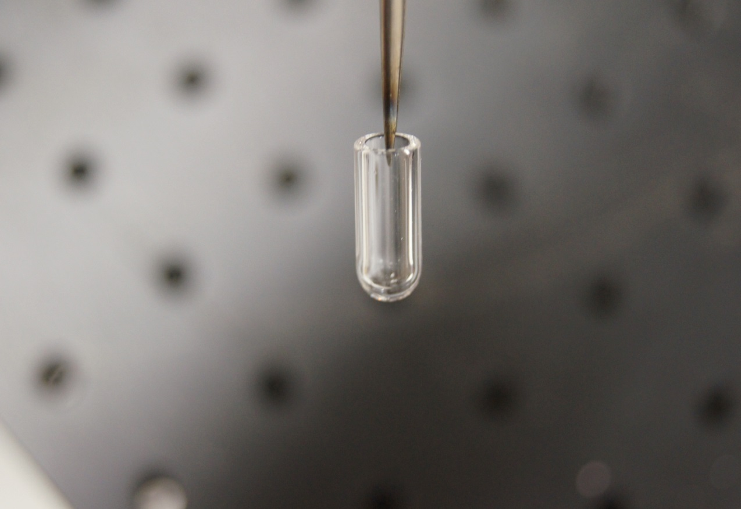
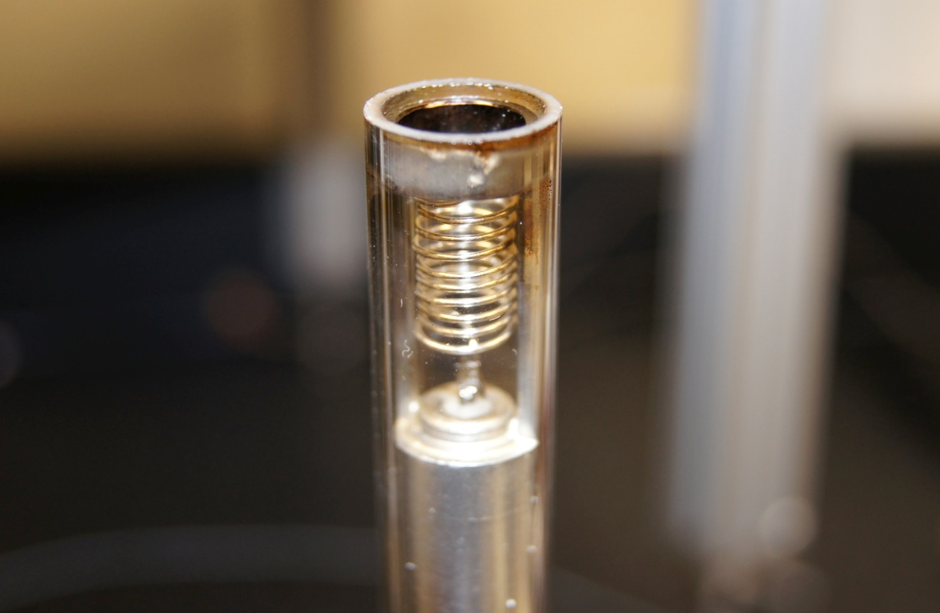
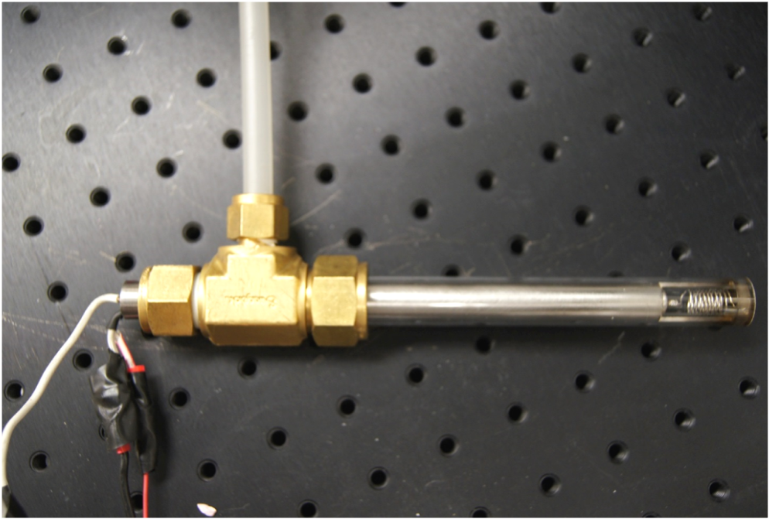
Pyrolyzer
Quartz tube
Sample tube
Purge gas
CDS 5000
Pyro-probe

Slide 19
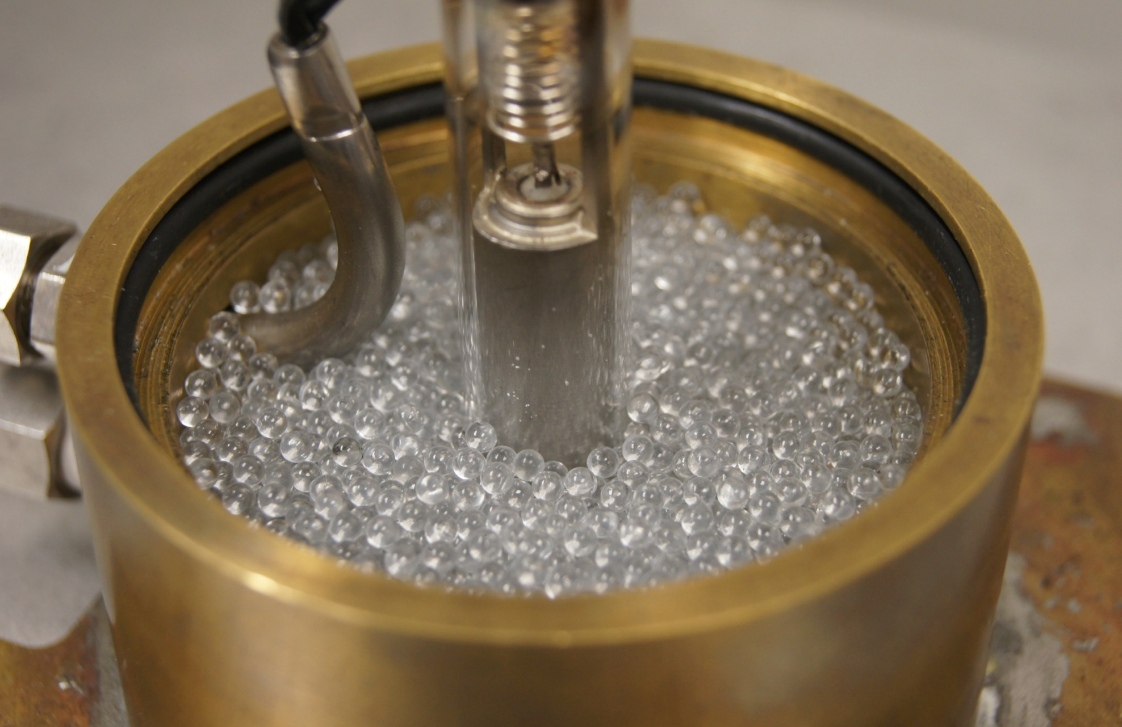
Base
Insert coflow and igniter hardware
Homogenize coflow
Seal assembly

Slide 20
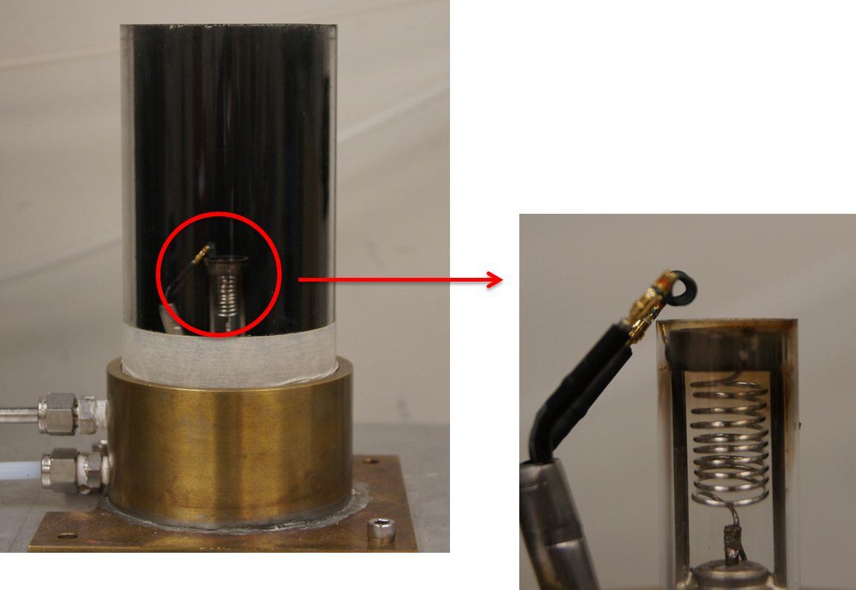
Combustion Chamber
Enclose combustion process
Provide optical access to the flame for gaining information like flame height, flame structure, combustion time

Slide 21
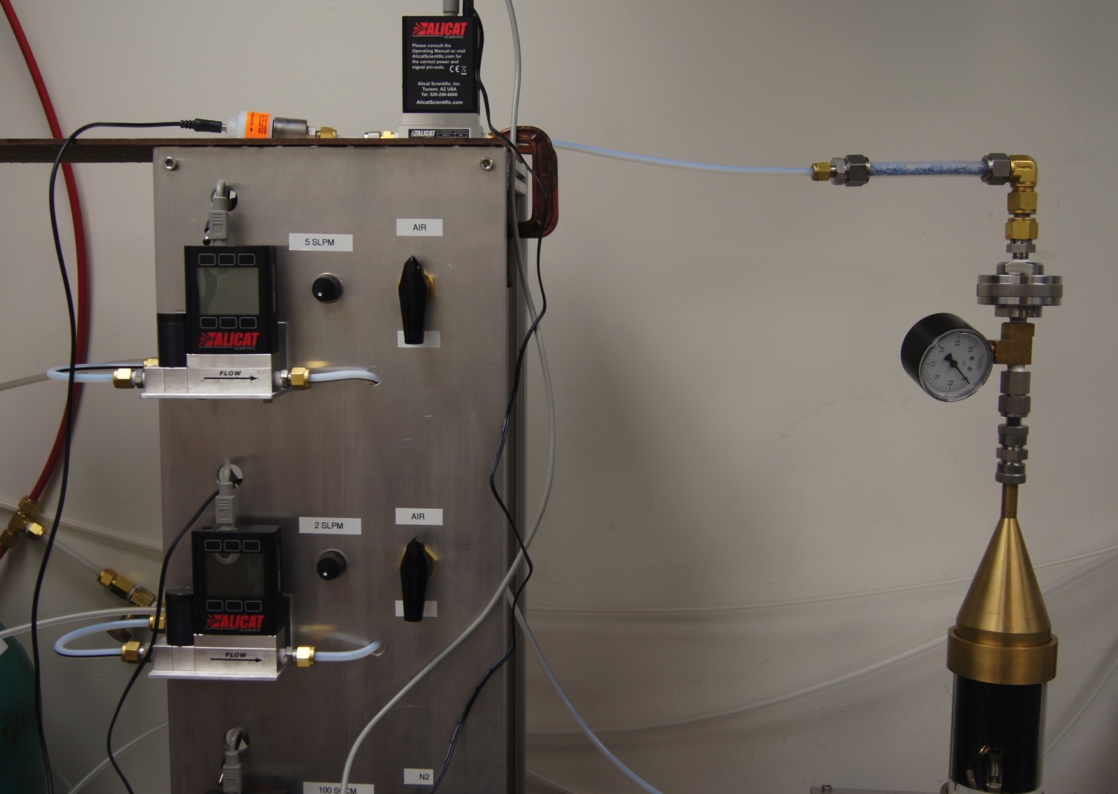
Gas Analyzing System
O₂ sensor
Drierite
Flow meter
Soot filter
Pressure gauge
Hood

Slide 22
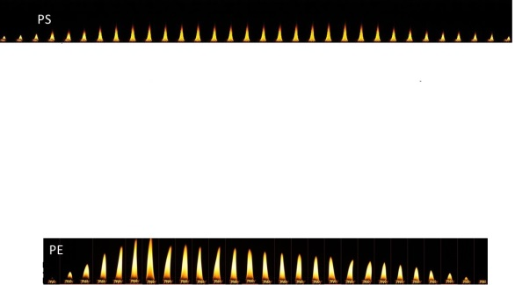
Capabilities
Co-flow | 0 - 6.32 SLPM
O₂ % in co-flow | 0-100%
Purge gas | 0-100 SCCM
Heating rate | 0-32 K/s
Co-flow | 4 SLPM
O₂ inlet concentration | 20-21% (Air)
Heating rate | 10 K/s
Purge gas (N₂) | 100 SCCM
Operating Conditions

Slide 23
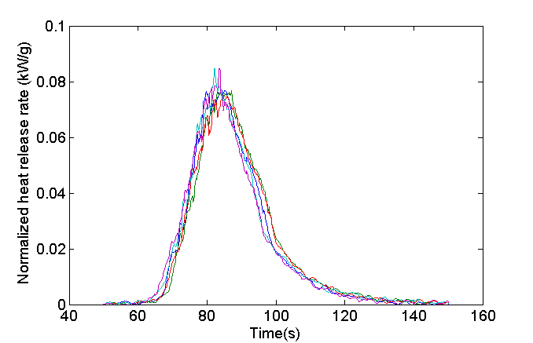
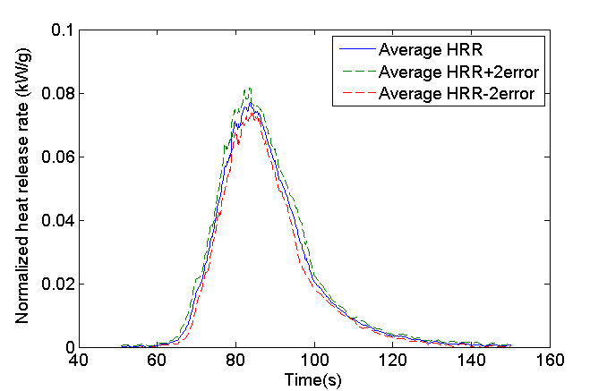
Repeatability
5 PMMA Tests

Slide 24
Calibration
Introduction
Flame Retardants
Current Test Methods
General Objectives
O₂ Consumption Calorimetry
MCC
Objectives and Approach
Apparatus Description
Calibration
Operation
Data Analysis
MFC
Objectives and Approach
Apparatus Description
Calibration
Operation
Data Analysis
Derived Data
MCC and MFC HRR
Combustion Efficiency
CO yields
Conclusions
Similar to MCC (share same flow controllers/meters and O₂ sensor type)
Pyrolyzer temperature profile determined with thermocouple embedded into ceramic filled sample tube (time→T)

Slide 25
Operation
Introduction
Flame Retardants
Current Test Methods
General Objectives
O₂ Consumption Calorimetry
MCC
Objectives and Approach
Apparatus Description
Calibration
Operation
Data Analysis
MFC
Objectives and Approach
Apparatus Description
Calibration
Operation
Data Analysis
Derived Data
MCC and MFC HRR
Combustion Efficiency
CO yields
Conclusions
Condition and prepare samples (~30 mg)
Replace soot filter
Open gas bottles. Activate flow controllers to desired setpoint
Load sample tube
Close system. Verify flowrate and O₂ signals
Run pyroprobe and DAQ
Output: Time, O₂ concentration, outlet flow rate

Slide 26
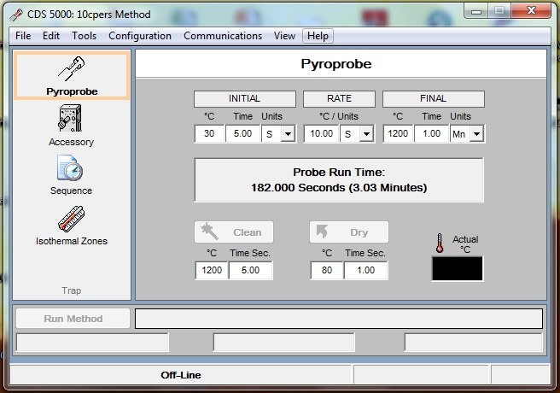
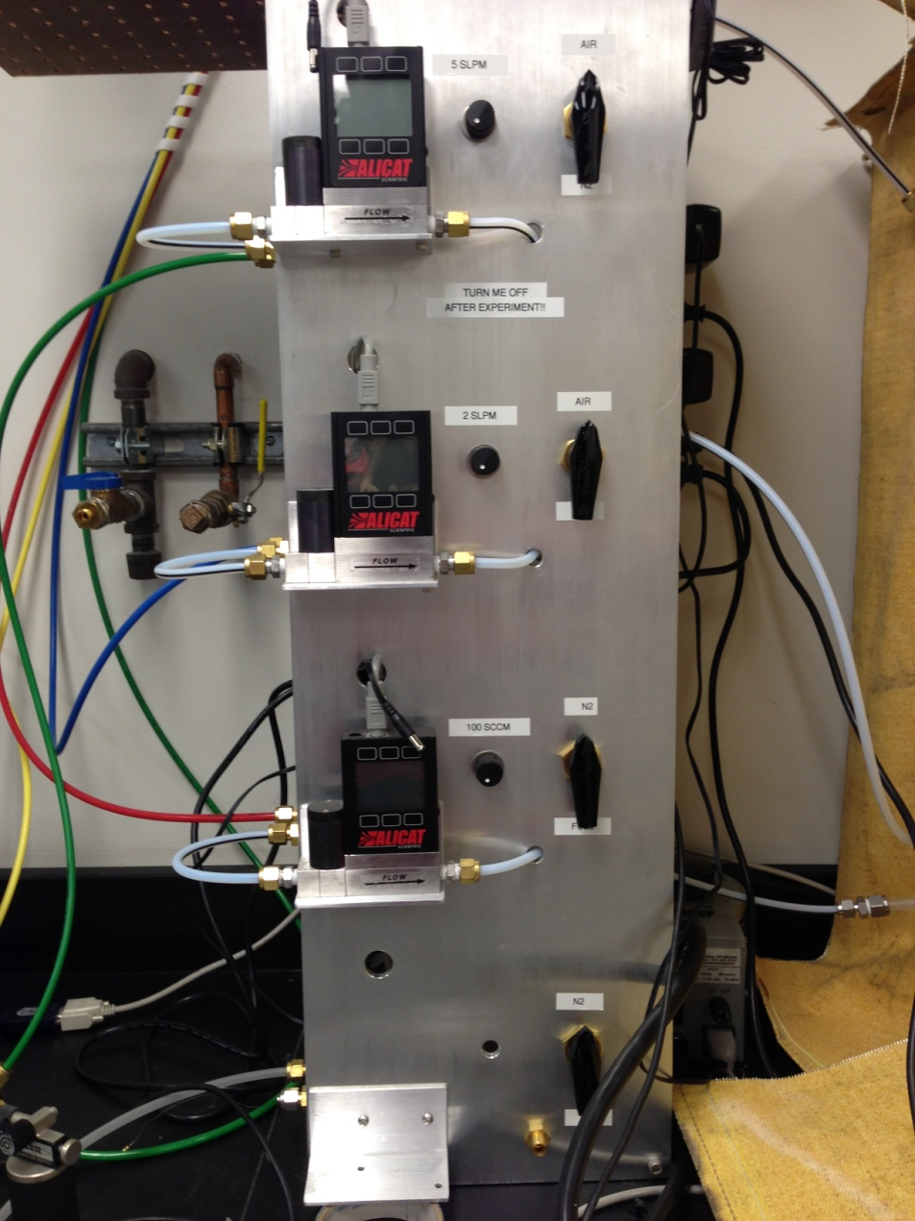
Operation
Introduction
Flame Retardants
Current Test Methods
General Objectives
O₂ Consumption Calorimetry
MCC
Objectives and Approach
Apparatus Description
Calibration
Operation
Data Analysis
MFC
Objectives and Approach
Apparatus Description
Calibration
Operation
Data Analysis
Derived Data
MCC and MFC HRR
Combustion Efficiency
CO yields
Conclusions

Slide 27
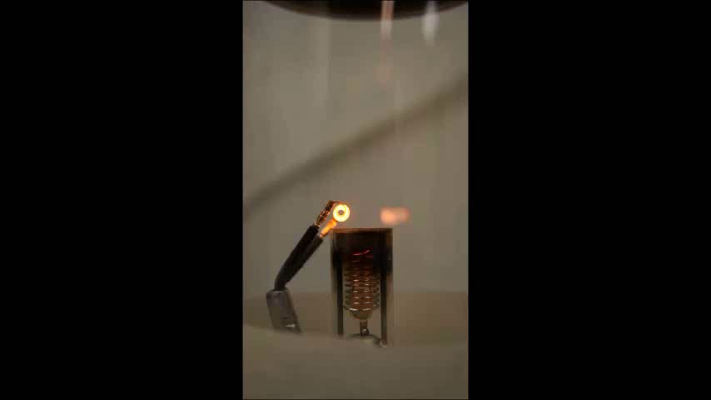
Flame Destabilization
Baseline PBT (no flame retardant)

Slide 28
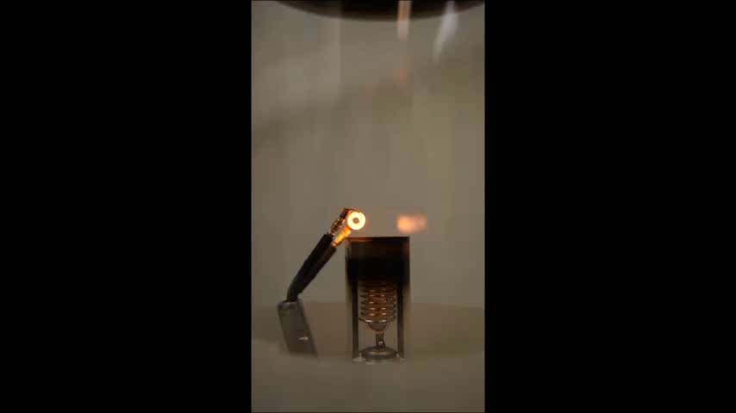
Flame Destabilization
55% PBT, 20% Al-DEP

Slide 29
Data Analysis
Introduction
Flame Retardants
Current Test Methods
General Objectives
O₂ Consumption Calorimetry
MCC
Objectives and Approach
Apparatus Description
Calibration
Operation
Data Analysis
MFC
Objectives and Approach
Apparatus Description
Calibration
Operation
Data Analysis
Derived Data
MCC and MFC HRR
Combustion Efficiency
CO yields
Conclusions
Matlab code
  Read in files
  Process data using 2 methods (MFC and MCC)
  MCC method
  Customizable output (HRR curves, total HR)

Slide 30
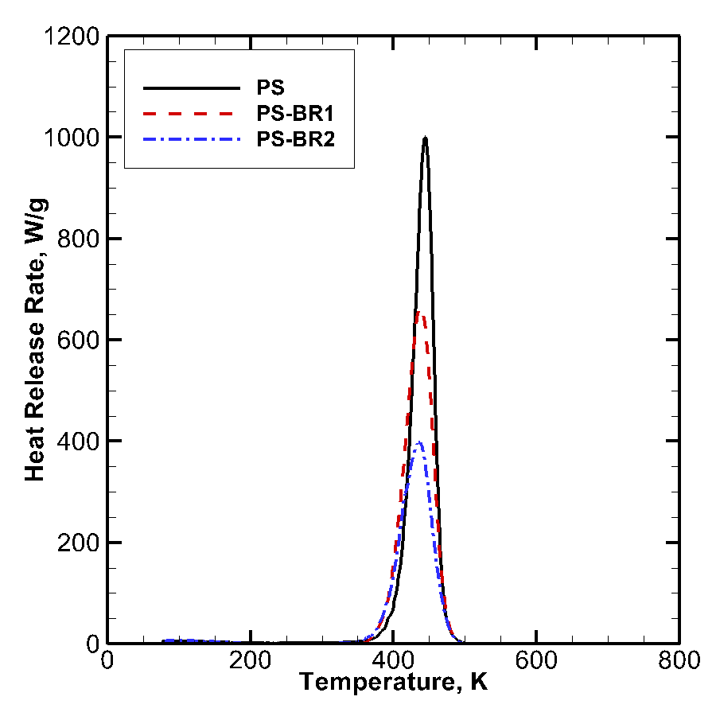
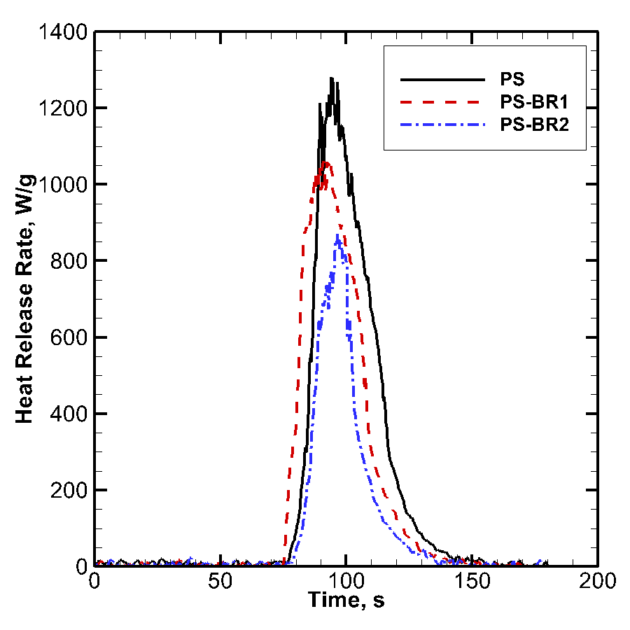
MCC and MFC HRR
,⁰C
MCC
MFC

Slide 31
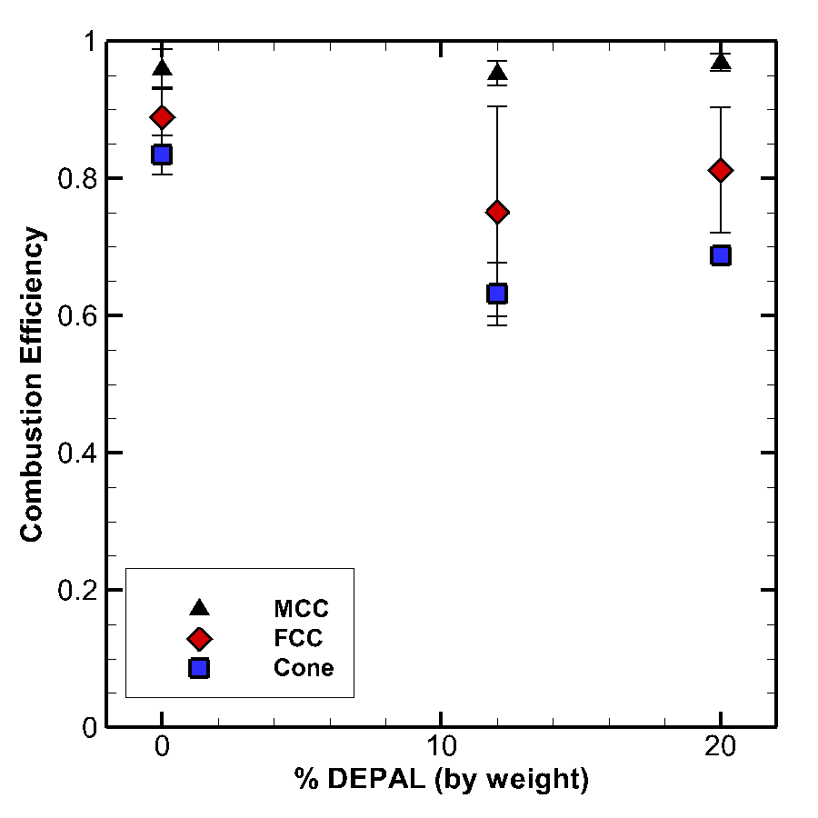
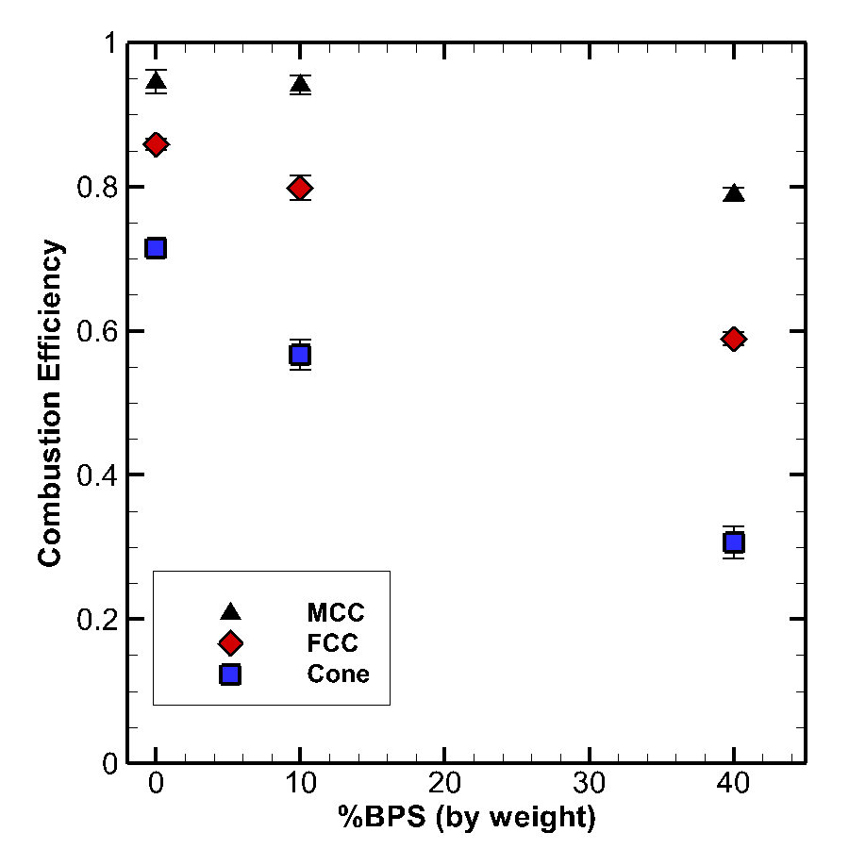
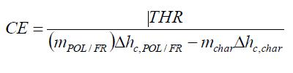
Combustion Efficiency
Stoichiometry or MCC data

Slide 32
CO Yields
For PS-FR2 ( 27.4 wt.% Br)
32%
Formation of soot
Gas phase combustion incompleteness:
43%
CO. yld (wt.%): 39.3%
Formation of CO and/or other incomplete combustion products
11%

Slide 33
Conclusions
Introduction
Flame Retardants
Current Test Methods
General Objectives
O₂ Consumption Calorimetry
MCC
Objectives and Approach
Apparatus Description
Calibration
Operation
Data Analysis
MFC
Objectives and Approach
Apparatus Description
Calibration
Operation
Data Analysis
Derived Data
MCC and MFC HRR
Combustion Efficiency
CO yields
Conclusions
There are currently 2 experimental techniques to measure heats of combustion using mg-sized samples, MCC and MFC
MCC → smallest sample size, total heat of combustion, not sensitive to FRs, no soot produced
MFC→ flaming combustion, sensitive to FRs, soot and char yields can be measured, optical thermometry can be applied

Slide 34
Bibliography
Lyon, R. et al., “A Microcombustion Calorimeter,” DOT/FAA/AR-01/117 Report http://www.tc.faa.gov/its/worldpac/techrpt/ar01-117.pdf
Ding, Xi, “Design and Implementation of the Flaming Combustion Calorimeter,” M.S. Thesis, University of Maryland, 2013

