Slide 1
Gas Chromatography
Lab Methods Day
June 25, 2014
Haiqing Guo
Dept. of Fire Protection Engineering
hguo@umd.edu

Slide 2
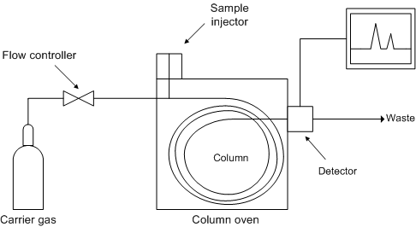
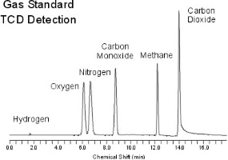
What is GC
Gas chromatography (GC), is a common type of chromatography used in analytical chemistry for separating and analyzing compounds that can be vaporized without decomposition.
The gaseous compounds being analyzed interact with the walls of the column, which is coated with a stationary phase. This causes each compound to elute at a different time.

Slide 3
Injector
Split/splitless injector
Splitless, sweep the entire sample into the column.
Split, sweep a portion of the sample into the column.
Gas switching valve
Online sampling, most common in combustion study.
Normally requires a 6-port sample valve.
On-column inlet
Programmable Temperature Vaporizing injector
Purge-and-Trap system

Slide 4
Injector
Position A
Vacuum Pump
6 Port Valve
Isokinetic sampling
Sample Loop
10µL
GC
Universal Trap
Regulator
Moisture Trap
Pressure Controller
Soot Filter
PC
Sample Probe
Carrier Gas

Slide 5
Injector
Position B
Vacuum Pump
6 Port Valve
Isokinetic sampling
Sample Loop
10µL
GC
Universal Trap
Regulator
Moisture Trap
Pressure Controller
Soot Filter
PC
Sample Probe
Carrier Gas

Slide 6
Detector
Thermal Conductivity Detector (TCD): This detector senses changes in the thermal conductivity of the column effluent and compares it to a reference flow of carrier gas.
Universal
Low sensitivity
Non destructible
Flame Ionization detector (FID): This detector is based on the detection of ions formed during combustion of hydrocarbon compounds in a hydrogen flame.
Complex system
Only for organic / hydrocarbon
High sensitivity
Destructible
Electron Capture Detector (ECD)
Photoionization Detector (PID)
……

Slide 7
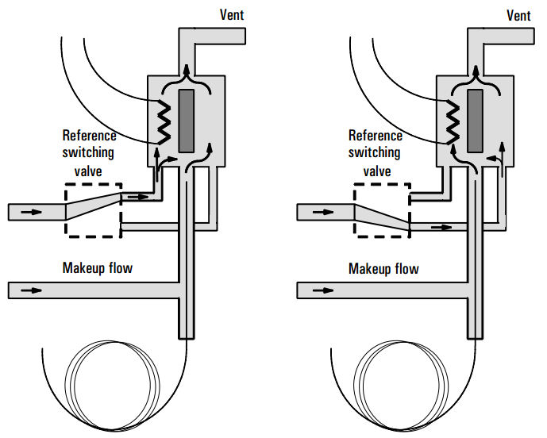
Detector
TCD
Heated filament
Gas flows through and changes filament T
Filament resistance changes
Wheatstone bridge circuit detects the change.

Slide 8
Column
Capillary Column
Stationary phase coated on the capillary tubing (mostly fused silica or stainless steel).
Diameters as small as 0.1 mm and lengths as long as 100 m.
High efficiency (narrow peaks).
Packed Column
Made of a glass or a metal tubing which is densely packed with a solid support.
Higher sample capacity.
Larger diameter and limited range of length.
Lower efficiency.
Oven temperature programing can be used to achieve the optimum separation of species in the column.

Slide 9
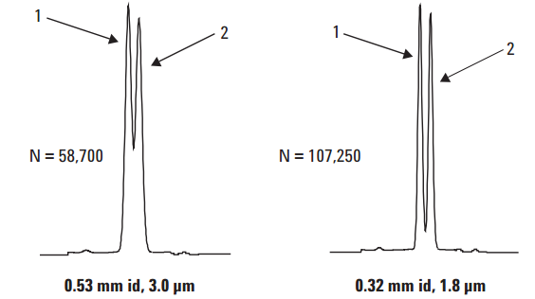
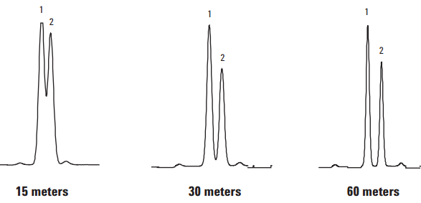
Column Selection
Selecting the stationary phase
Polarity
Gas-solid or PLOT (Porous Layer Open Tubular)
…
Column diameter
Column length
Column film thickness
Consult sample applications provided by GC manufacturers.

Slide 10
Carrier Gas
Helium, Hydrogen, Argon, Nitrogen, etc.
Purity between 99.995% - 99.9995% and contain a low levels (< 0.5 ppm) of oxygen and total CH in the tank.
He/H₂ gives higher sensitivity with TCD because of a higher difference in thermal conductivity between the sample and the carrier gas.

Slide 11
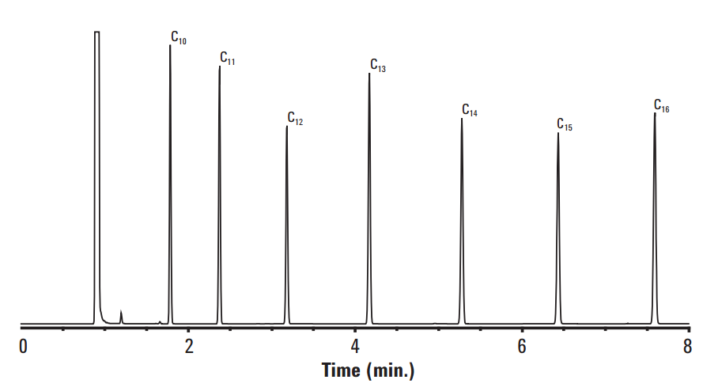
Post Processing
Baseline
Integrate Area

Slide 12
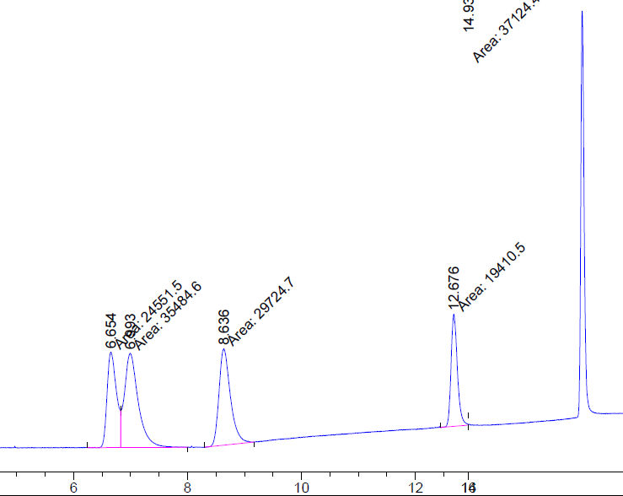
Post Processing
Drifted baseline
Baseline noise
Unseparated peaks
Tailing peak

Slide 13
Calibration
The detector’s response to different species is different.
Gas standard (calibration gas mixture with known concentrations) is used to:
Get the species retention time. (knows which peak belongs to which species)
Obtain correlation between the response (integrated area) and the concentration

Slide 14
GC
HP 5890 series II
TCD detector
Gas switching valve inject
Column: Carboxen 1010
10 µL sample loop
Method: (Need to be consistent)
Oven: 35 °C (7.5 min.) to 250 °C at 24 °C/min, hold for 5 min.
Inj.: 200 °C
Det.: 230 °C
Flow: Helium, 3.0 mL/min.
Valve: 150 °C

Slide 15
Limitations
Long response time
Very sensitive to leakage
Very sensitive to contamination
Suggested Reference: Official User Manual
https://www.chem.agilent.com/Library/usermanuals/Public/G3430-90011.pdf

